Slide 1
Municipal Bond Market Database
New College of Florida
12/1/2025
Mark Crisci (ER and Data Story), Muhammed Altindal (Key Insights and Reflection), and Avery Bishop (Research Question and Why)

Slide 2
Big Picture-Research Question
New College of Florida
12/1/2025
Which states and issuer groups dominate municipal bond issuance, and what trends in coupon rates, liquidity, credit sentiment, and risk can we observe?

Slide 3
Big Picture-Why?
New College of Florida
12/1/25
Investors understanding of high-risk and undervalued bonds
Highlighting which states borrow, their frequency and cost

Slide 4
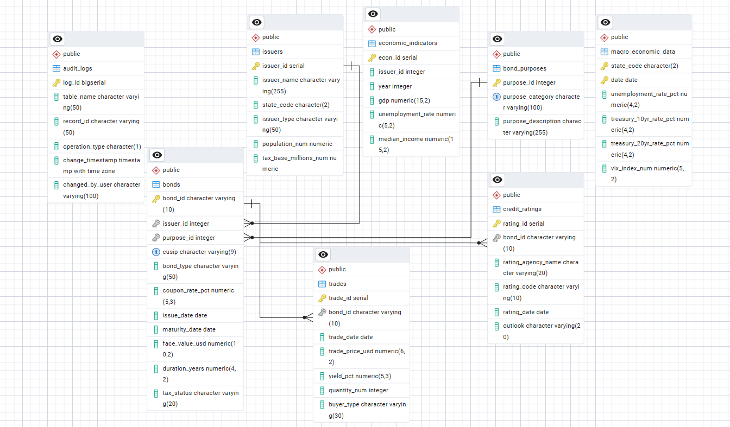
ER Diagram
New College of Florida
12/1/2025

Slide 5
Data Story
New College of Florida
12/1/2025
Joined bonds, issuers, purposes, trades, and ratings, filtered latest ratings and dates
Challenge: selecting only most recent credit rating for each bond while joining and aggregating yields

Slide 6
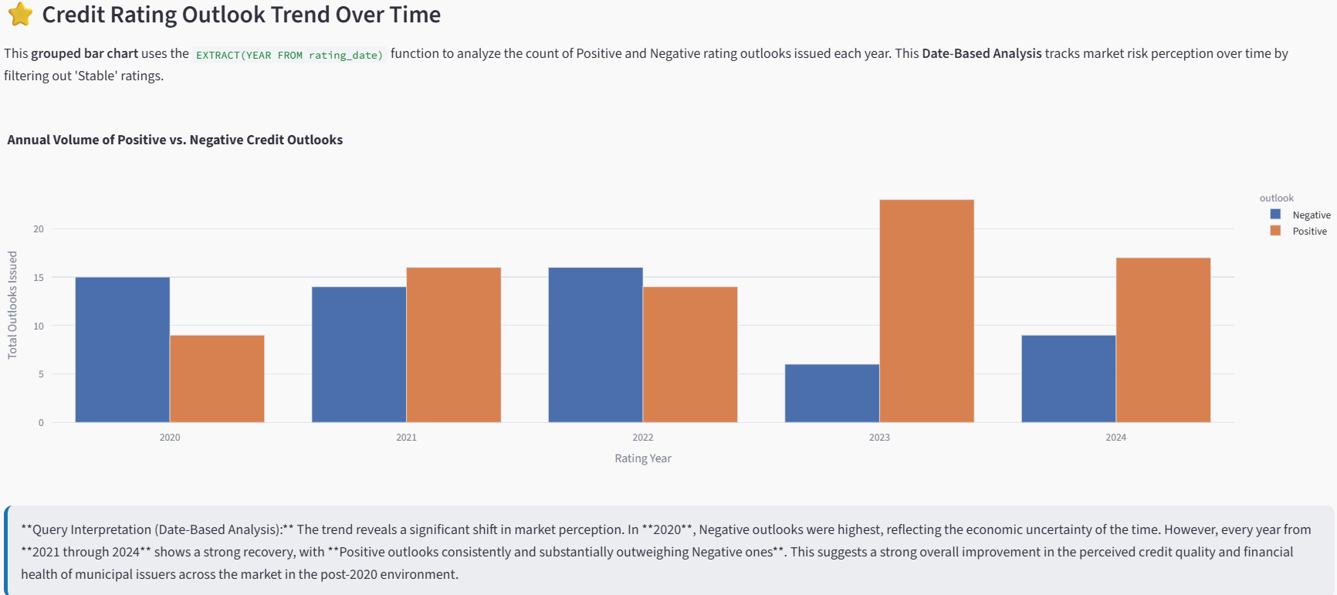
Key Insights
New College of Florida
12/1/2025

Slide 7
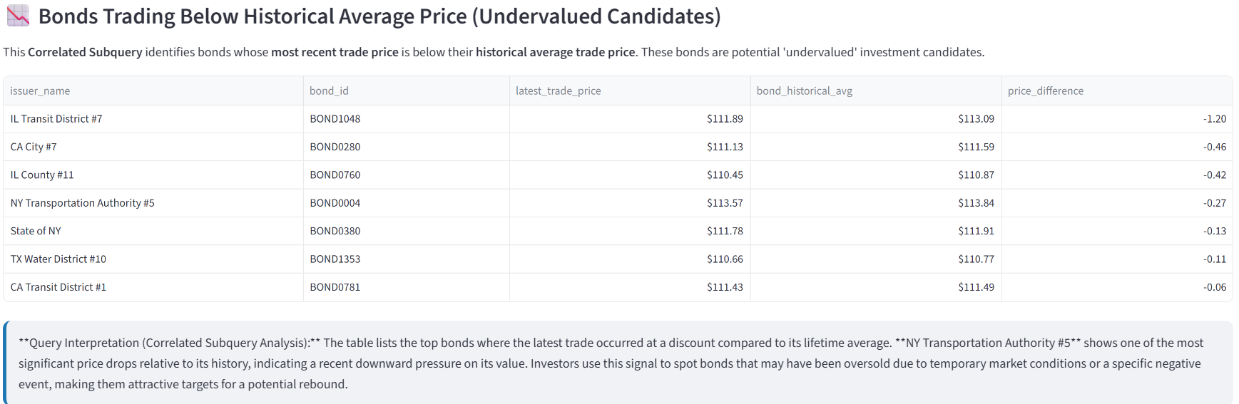
Key Insights
New College of Florida
12/1/2025

Slide 8
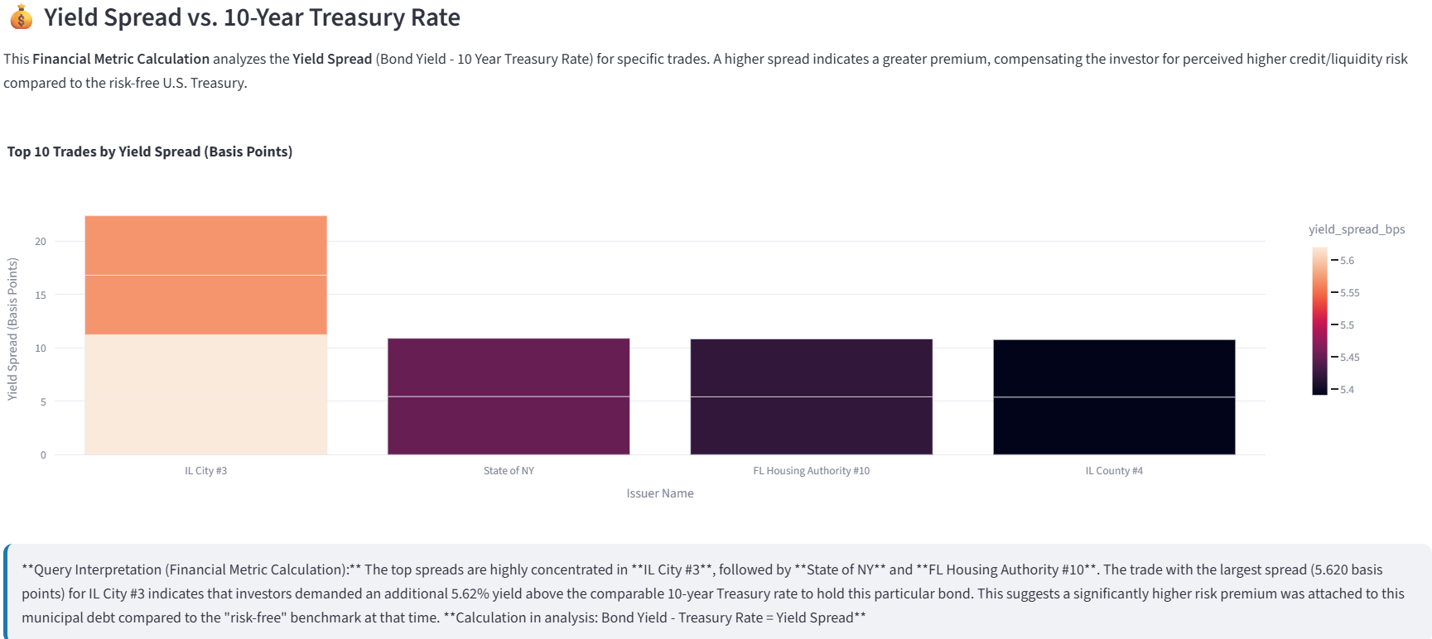
Key Insights
New College of Florida
12/1/2025

Slide 9
Reflection
New College of Florida
12/1/2025
Surprising to see some bonds trading for notably lower than their historical averages
Extension: Seeing whether macroeconomic factors directly impact bond yields across states
Clear understanding of how highlighting trends brought upon by joining datasets can lead to actionable knowledge

